Slide 1
Secure Communication Architecture Between Vehicle Gateway and AWS IoT Core
A comprehensive guide to building robust, certificate-based vehicle-to-cloud communication without AWS Greengrass

Slide 2
Overview of Secure Vehicle-to-Cloud Communication
Core Architecture Components
Cloud Integration
The Gateway_Device runs Python with the paho-mqtt library, establishing a lightweight yet powerful foundation for vehicle connectivity. Using MQTT protocol over TLS 1.2+ ensures all messaging remains encrypted and secure throughout transmission.
Authentication leverages X.509 certificates to establish identity and trust between devices and cloud infrastructure, creating a robust security perimeter.
This architecture eliminates complexity while maintaining security, scalability, and reliability for modern connected vehicle deployments.
AWS IoT Core serves as the central MQTT broker and comprehensive device manager, orchestrating all vehicle communications. AWS backend services seamlessly process and store vehicle data with enterprise-grade security.

Slide 3
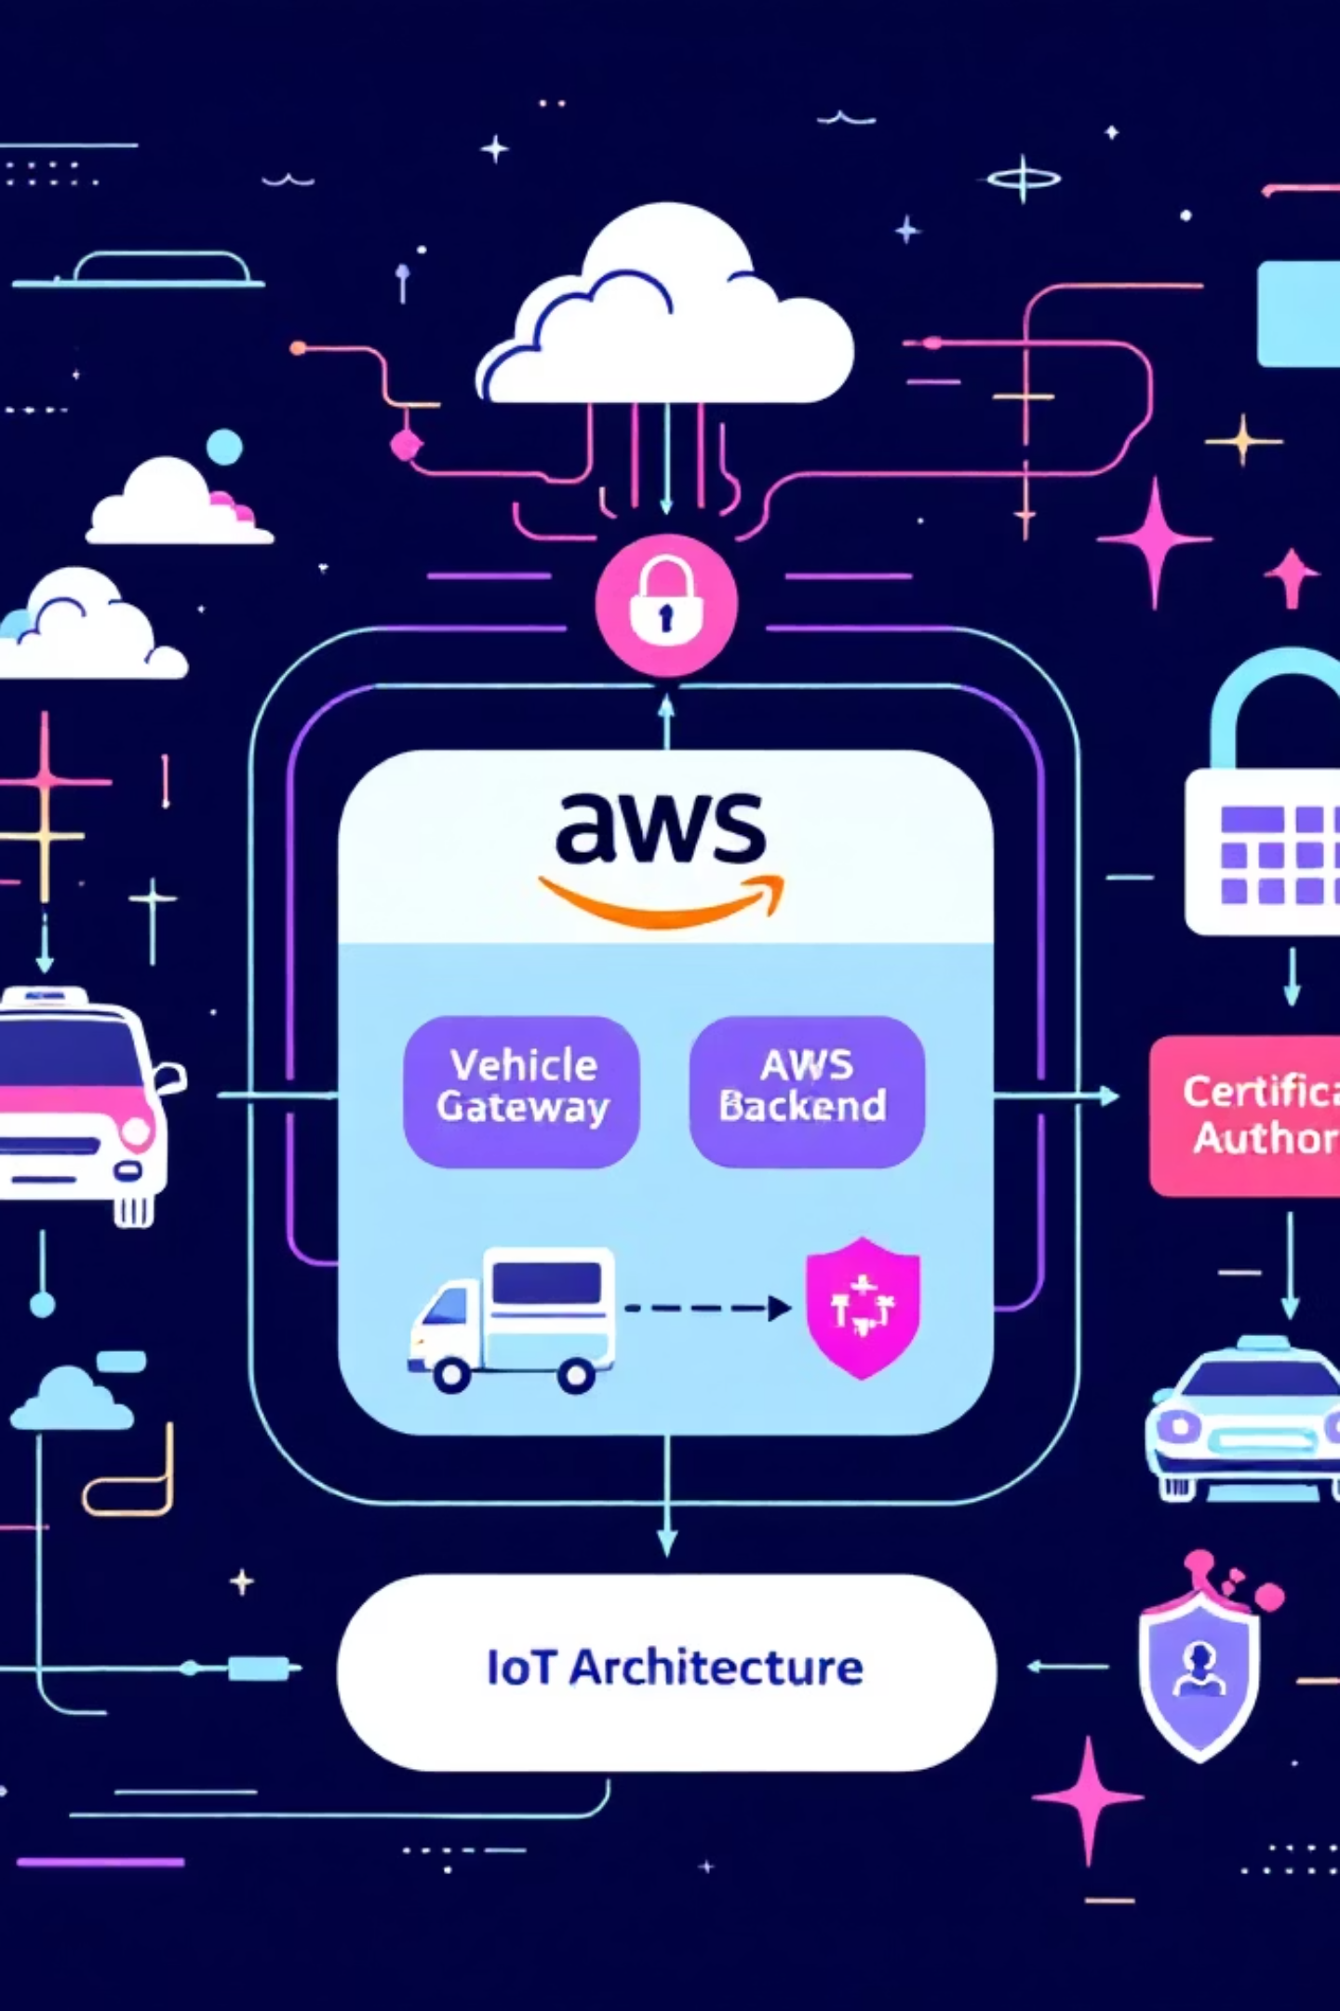
Architecture Diagram: High-Level Components
Vehicle Gateway
Python + paho-mqtt client, X.509 certs
AWS IoT Core
MQTT broker, mTLS authenticated
AWS Backend
Amazon ECS, DynamoDB, S3 (encrypted)
Certificate Authority
Issues X.509 certs to gateway

Slide 4



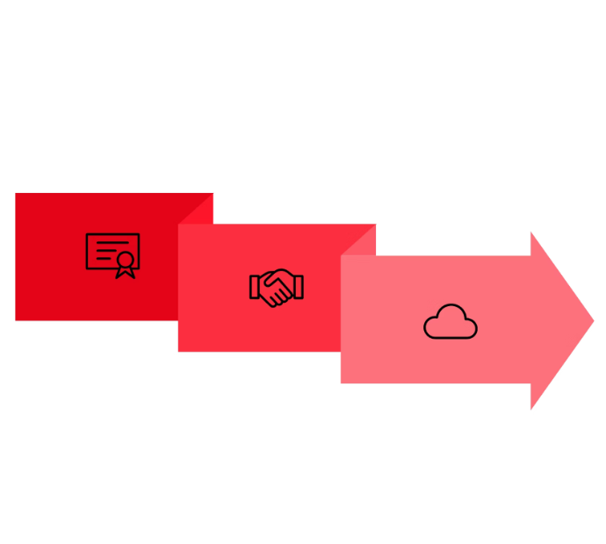
Vehicle Gateway: Identity & Secure Connection
Certificate Provisioning
Each Vehicle Gateway receives a unique X.509 certificate and private key during secure onboarding, establishing its digital identity in the fleet.
Client Configuration
The MQTT client is configured with paho-mqtt using TLS 1.2+ and client certificates, ensuring encrypted communication from the start.
Mutual TLS Handshake
Gateway establishes an mTLS connection to the AWS IoT Core endpoint, with both parties validating each other's certificates for mutual authentication.
↔
TLS Handshake
Vehicle Gateway
AWS IoT Core

Slide 5
MQTT Publish/Subscribe Workflow
01
02
03
Publishing Telemetry
Subscribing to Commands
Encryption & QoS
Vehicle Gateway publishes real-time telemetry data to AWS IoT Core MQTT topics, transmitting sensor readings, diagnostics, and operational metrics.
Gateway subscribes to command topics for receiving remote instructions, enabling bidirectional communication for vehicle management.
All MQTT messages are encrypted via TLS 1.2+ with mutual authentication. Topic aliasing and QoS settings optimize bandwidth and ensure reliable delivery.

Slide 6




AWS IoT Core: Secure Broker and Identity Management
Certificate Validation
Policy Enforcement
Validates client certificates against AWS IoT Core registered identities, ensuring only authorized devices can connect.
Enforces granular authorization policies per device and topic, controlling exactly what each gateway can publish and subscribe to.
Protocol Support
Message Routing
Supports MQTT v3.1.1 and MQTT v5 features for enhanced scalability, control, and modern messaging capabilities.
Routes messages securely to backend services via the rules engine, enabling real-time processing and integration.

Slide 7

Certificate Lifecycle Management
Certificate Issuance
1
X.509 certificates provisioned via AWS Private CA or external CA during vehicle onboarding with secure key generation.
2
Secure Storage
Private keys stored in TPM or HSM on Vehicle Gateway, protecting cryptographic material from unauthorized access.
Deployment
3
Certificates deployed to vehicles through secure channels, establishing trusted identity for cloud communications.
4
Rotation
Automated certificate rotation managed via AWS IoT Device Management before expiration, maintaining continuous security.
Revocation
5
Compromised certificates immediately revoked and blocked, protecting the entire fleet from security breaches.
Continuous trust is maintained through automated lifecycle management, mitigating risks from compromised credentials and ensuring long-term security posture.

Slide 8
Security Best Practices Summary
1
2
3
Mutual TLS Encryption
Unique Device Identity
Least Privilege Access
Always use mutual TLS (TLS 1.2 or higher) for encrypted, authenticated communication between vehicle gateways and AWS IoT Core, protecting data in transit.
Employ unique X.509 certificates per vehicle gateway to establish individual identity, enabling precise access control and accountability.
Limit MQTT topics and permissions via AWS IoT Core policies, granting devices only the minimum access required for their specific functions.
4
5
Continuous Monitoring
Automated Lifecycle
Monitor device behavior with AWS IoT Device Defender to detect anomalies, security violations, and potential threats in real-time.
Automate certificate lifecycle management including rotation and revocation to maintain strong security posture without manual intervention.

Slide 9



Conclusion: Robust, Scalable, and Secure Vehicle Communication
Lightweight Gateway
Strong Authentication
Scalable Processing
Python with paho-mqtt enables lightweight, secure MQTT clients directly on vehicle hardware without heavy frameworks.
X.509 certificates combined with TLS 1.2+ ensure strong authentication and encryption without requiring AWS Greengrass complexity.
AWS IoT Core and backend services provide scalable, secure data processing that grows with your fleet size and data volume.
This architecture supports modern connected vehicle needs with proven AWS security standards, delivering a production-ready solution that is secure, manageable, and extensible for vehicle-to-cloud communication at any scale.

Slide 10
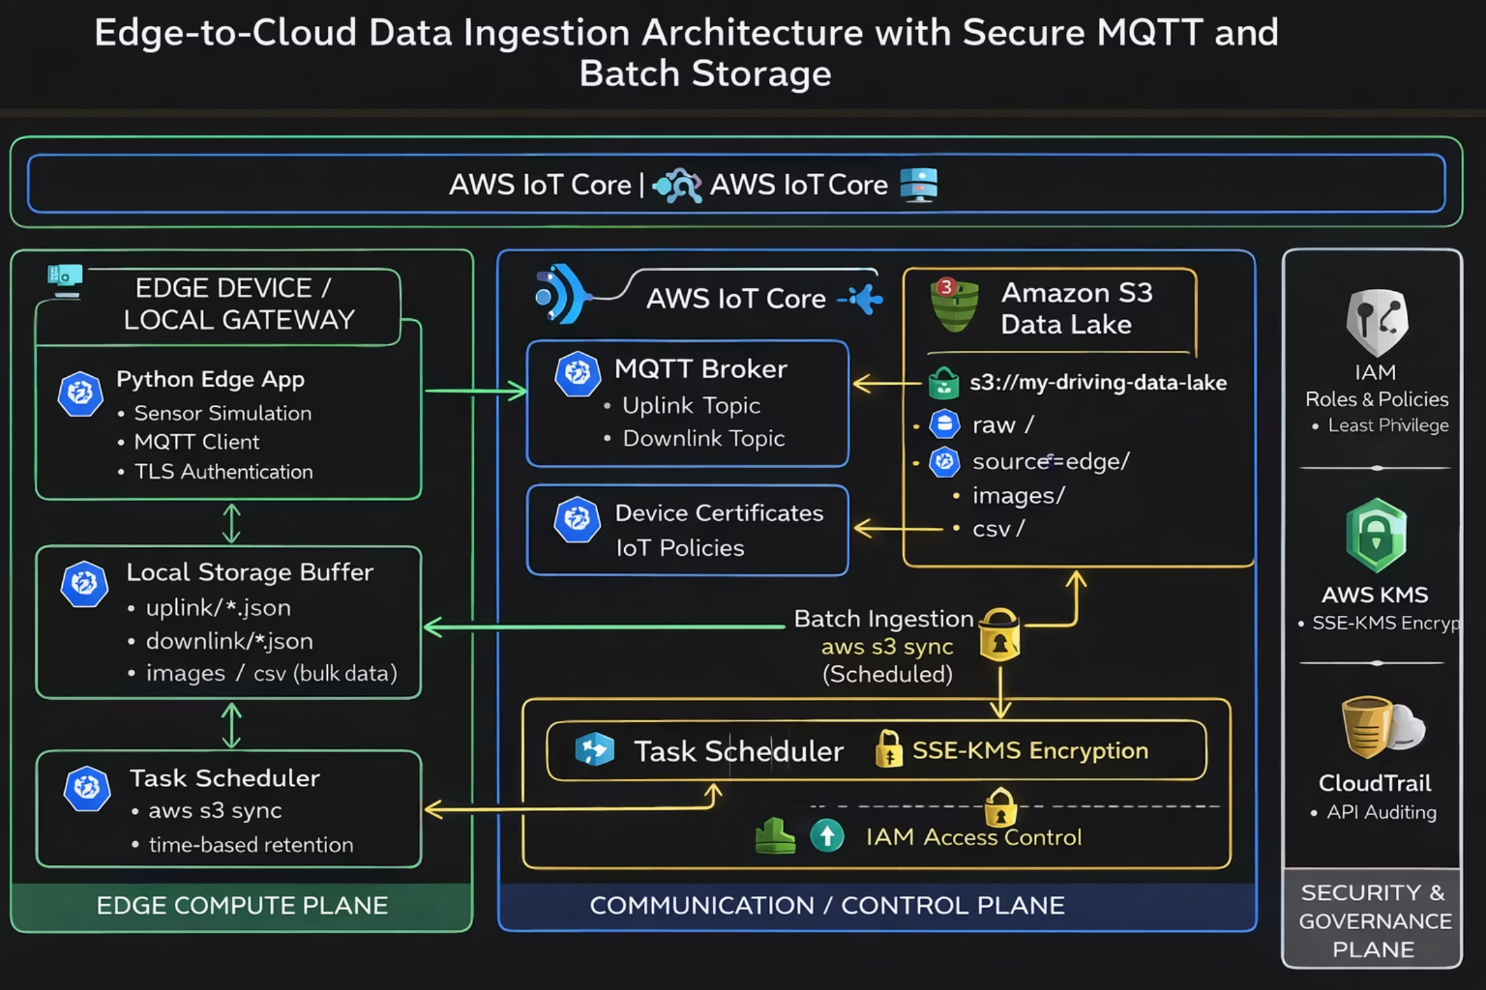

Slide 11
Data Ingestion & Storage Architecture
Designing and implementing a scalable, secure data ingestion and storage layer for edge devices, supporting both structured and unstructured data with efficient batch ingestion patterns.

Slide 12
Edge Data Characteristics
Data Sources
Data Properties
Our edge environment generates diverse data streams from multiple sources:
Key characteristics that shape our architecture decisions:
High volume output, especially images and logs
Edge device local gateway
Mixed formats combining structured and unstructured data
Sensor telemetry (JSON format)
Control messages (JSON format)
Continuously generated at the edge
Images (JPG format)
Demands secure and reliable storage solutions
CSV datasets including labels and logs

Slide 13




Ingestion Strategy
Real-Time Ingestion
Batch Ingestion
MQTT over TLS to AWS IoT Core enables immediate bidirectional communication for uplink telemetry and downlink control messages.
Scheduled aws s3 sync from edge device to Amazon S3 handles large file transfers efficiently and reliably.
Why Batch Ingestion?
Efficient Large File Handling
Reduced Network Usage
Optimized for transferring images, CSV files, and other large objects without overwhelming network resources.
Scheduled synchronization minimizes bandwidth consumption during peak operational periods.
Improved Reliability
Data Durability
Operates effectively during intermittent connectivity scenarios common in edge deployments.
Ensures local persistence before cloud upload, preventing data loss during transmission failures.

Slide 14




Raw Data Lake Design
The Raw Zone serves as our single source of truth, storing original, unmodified data exactly as generated by edge devices. This preservation approach ensures data integrity and enables downstream reprocessing.
Images (.jpg)
CSV Files (.csv)
High-resolution captures from edge cameras and sensors
Structured datasets including labels, logs, and tabular data
Uplink Telemetry (.json)
Downlink Commands (.json)
Device-to-cloud sensor readings and status updates
Cloud-to-device control messages and configuration updates
Storage Structure
s3://my-driving-data-lake/
└── raw/
└── source=edge/
└── device=my_local_gateway_01/
├── images/
├── csv/
├── uplink/
└── downlink/

Slide 15
Batch Ingestion Pipeline
Pipeline Execution
Our edge-based ingestion pipeline operates autonomously to ensure reliable data transfer:
Runs directly on the edge device
Scheduled using OS-level task scheduler (cron/Task Scheduler)
Leverages AWS CLI aws s3 sync command
Intelligently detects and uploads only new or modified files

Slide 16

Storage Scalability & Durability
Amazon S3 Benefits
Unlimited Capacity
Extreme Durability
Virtually unlimited storage capacity scales seamlessly with data growth, eliminating capacity planning concerns.
High durability (99.999999999%) ensures data is protected against hardware failures and corruption.
Optimized Performance
Format Flexibility
Architected specifically for large object ingestion with high throughput and low latency.
Natively supports both structured and unstructured data without transformation requirements.
Design Outcome: Our implementation delivers elastic storage that scales with data volume, maintains consistent performance during high-volume ingestion, and makes data immediately available for downstream processing and analytics.

Slide 17



Security & Access Control
Encryption at Rest
TLS Encryption
Least-Privilege Access
Server-side encryption using SSE-KMS with customer-managed keys for granular control
All MQTT communication secured using mutual TLS certificates for encryption in transit
IAM policies enforce minimal necessary permissions for each service and user role
Device Authentication
Isolated Credentials
Device identity rigorously enforced via AWS IoT Core certificate-based authentication
Separate IAM credentials dedicated exclusively for edge device ingestion

Slide 18
Device & Communication Security
Our real-time communication security relies on robust protocols and continuous monitoring. MQTT over TLS ensures encrypted communication between edge devices and AWS IoT Core, while X.509 certificates uniquely identify and authenticate each device.
Proactive Monitoring with AWS IoT Device Defender
AWS IoT Device Defender (Detect) provides early warning of anomalous device behavior by monitoring:
1
2
Unexpected Disconnects
Abnormal Message Rates
Detects abrupt loss of connection from edge devices, signaling potential issues.
Identifies unusual patterns in data transmission, such as unexpected spikes or drops.
3
4
Unauthorized Topic Access
Authentication Failures
Flags attempts by devices to access data topics they are not authorized to interact with.
Identifies repeated failed authentication attempts, indicating potential security breaches.

Slide 19
Audit, Compliance & Metadata
CloudTrail Integration
Data Organization
Comprehensive audit logging provides full visibility into data ingestion activities:
Data is systematically categorized using directory-based and system metadata:
Complete Logging
Source Classification: Identifies origin (edge vs. cloud-generated)
All S3 API actions automatically logged including uploads, deletions, and access attempts
Device Identification: Unique device ID for multi-device deployments
Type Categorization: Segregates images, CSV files, and telemetry
Dedicated Storage
Logs stored in a separate, restricted audit bucket with long-term retention policies
Object Timestamps: Creation and modification times for temporal analysis
Version History: S3 versioning maintains complete object lifecycle

